Slide 1

CLIENT SERVER PROGRAMMING USING DUAL STACK (IPv4 and IPv6) HOST
Batch Details : Batch 16
Name USN
S Bharath 1NT18EC134
Shaik Abdul Aleem 1NT18EC143
Likith N 1NT18EC083
Rizwan Khan 1NT18EC130
Project Supervisor
Prof. Sitaram Yaji
Professor Dept. of Electronics and Communication Engineering
Nitte Meenakshi Institute of Technology Yelahanka, Bangalore-560064

Slide 2
Presentation Outline
Introduction
Project Objectives
Basic Architecture
Client Server Programming Using Socket APIs
Experimental Results
Project Timeline
Work Assigned
27-Oct-21

Slide 3
Introduction
The internet can be accessible worldwide which is system of interconnected networks. Two current versions of the Internet Protocol (IPv4 and IPv6 ) are provided by Internet Assigned Numbers Authority (IANA).
IPv4 protocol was already allotted to Regional Internet Registries (RIR) and there is no more IPv4 address to allot and IANA has started issuing the IPv6 address to RIR. In February 2011, all IPv4 addresses had vanished and now we are going for IPv6.
Therefore several mechanisms are required which ensures smooth, stepwise an independent change to IPv6. Not only is the transition, integration of IPv6 is also required into the existing networks.
The solutions (or mechanisms) can be divided into three categories: dual stack, tunneling and translation.
Dual-stack is a preferred, most versatile way to deploy IPv6 in existing IPv4 environments.

Slide 4
Project Objectives
The following are the proposed objectives of the project based on the research:
To Implement client server communication between dual stack host and IPv4 only host
To Implement client server communication between dual stack host and IPv6 only host
To implement both of above simultaneously
To implement Seminar hall booking application (Dual stack host and IPv4 only host)
To implement IP IVR system(Dual stack host and IPv6 only host)

Slide 5
Basic Architecture
Three Hosts on LAN
Host 1 IPv4/IPv6 (LAN interface should have both IPv4 and IPv6 addresses)
Host 2 IPv4 only
Host 3 IPv6 only
Host 1 -
One server program for NMIT seminar hall booking application (using IPv4)
Second server program for application - NMIT IP IVR (interactive voice response) system (using IPv6)
Both servers will be running at the same time
Host 2
One client program for NMIT seminar hall booking application (using IPv4)
Host 3
One client program for application - NMIT IP IVR(interactive voice response) system (using IPv6)
Note: Works for WAN also (Assuming IPv6 routing also enabled in WAN)

Slide 6
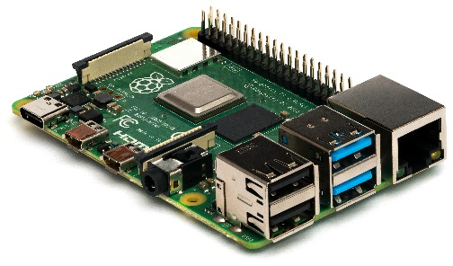

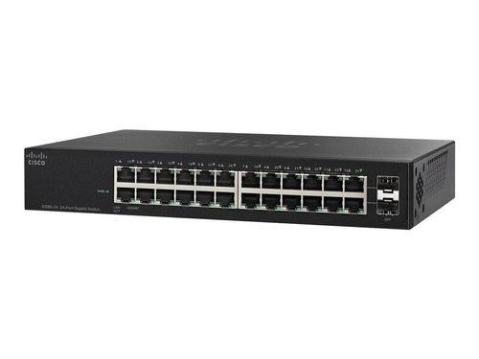
Three Hosts on LAN
Raspberry Pi
(IPv6 only)
Switch
Dual Stack Host (IPv4 and IPv6)
Linux System
(IPv4 only)
Note : Works for WAN also (assuming routers in WAN can route IPv6 packets)

Slide 7
IPv6 Only Host
Dual Stack Host
IPv4 Only Host
Application Layer
Message
Application Layer
Message
Application Layer
Message
Transport Layer
UDP /UDP Segment
Transport Layer
TCP /UDP Segment
Transport Layer
TCP /UDP Segment
Internet Layer
IPv6 Datagram
Internet Layer
IPv6 /IPv4 Datagram
Internet Layer
IPv4 Datagram
Data Link Layer
Frame
Data Link Layer
Frame
Data Link Layer
Frame
Physical Layer
Bits
Physical Layer
Bits
Physical Layer
Bits
Network Media

Slide 8
Client Server Programming Using Socket APi
Client
Server
Socket
Socket
Bind
Bind
Connect
Listen
Accept
Process inside the bracket will happen when request of client is accepted
Send to/ Recv from
Recv from/ Send to
Close
Close
8

Slide 9
Experimental Results

Slide 10
Objective 1
Client Server communication between dual stack host and IPv4 only Host

Slide 11
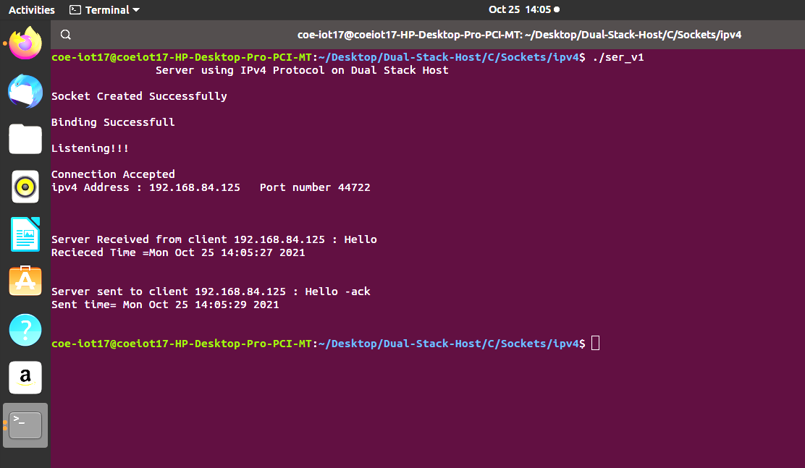
Server Using IPv4 Protocol on Dual Stack Host

Slide 12
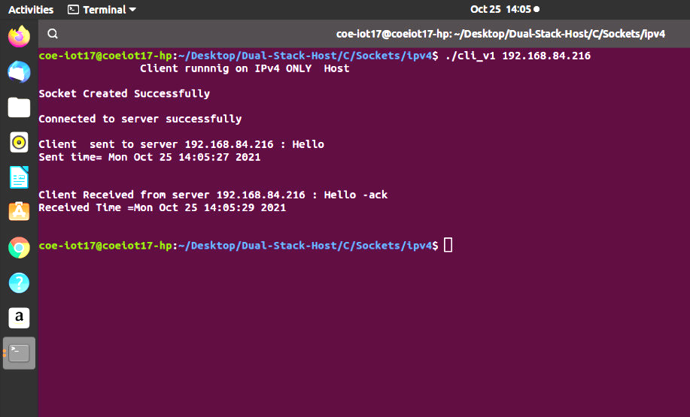
Client running on IPv4 Only Host

Slide 13
Objective 2
Client Server communication between dual stack host and IPv6 only Host

Slide 14
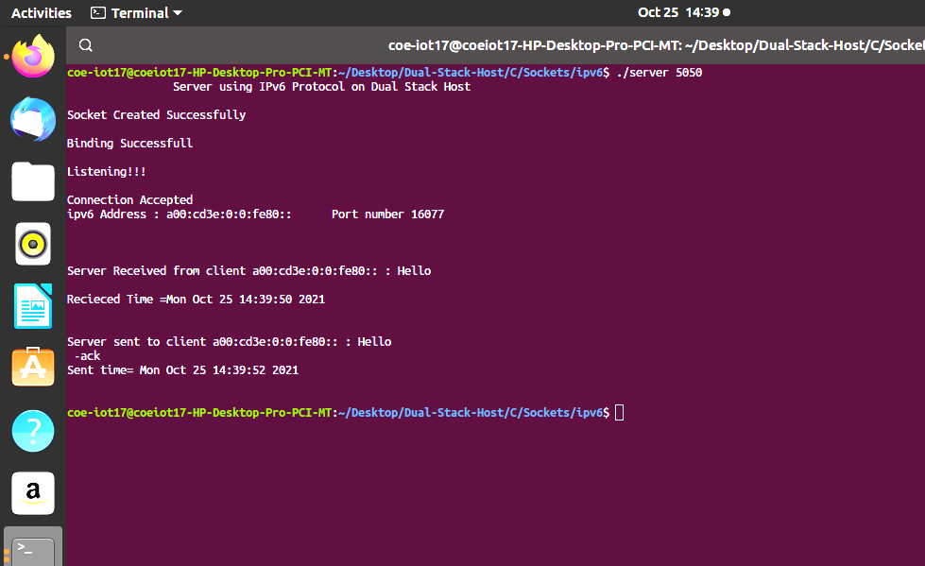
Server Using IPv6 Protocol on Dual Stack Host

Slide 15
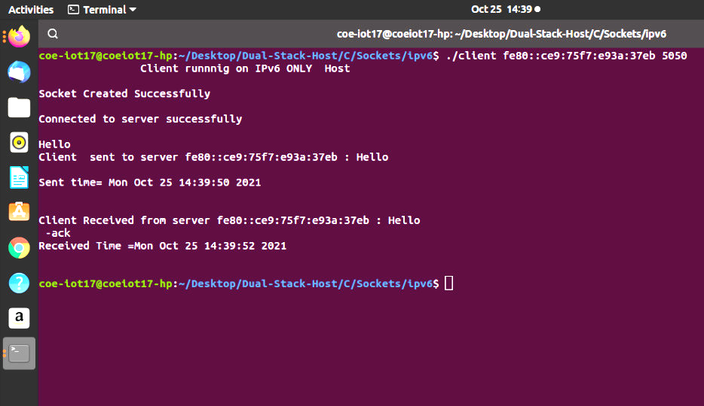
Client running on IPv6 Only Host

Slide 16
Objective 3
Client Server communication between dual stack host and IPv6/IPv4 Host

Slide 17
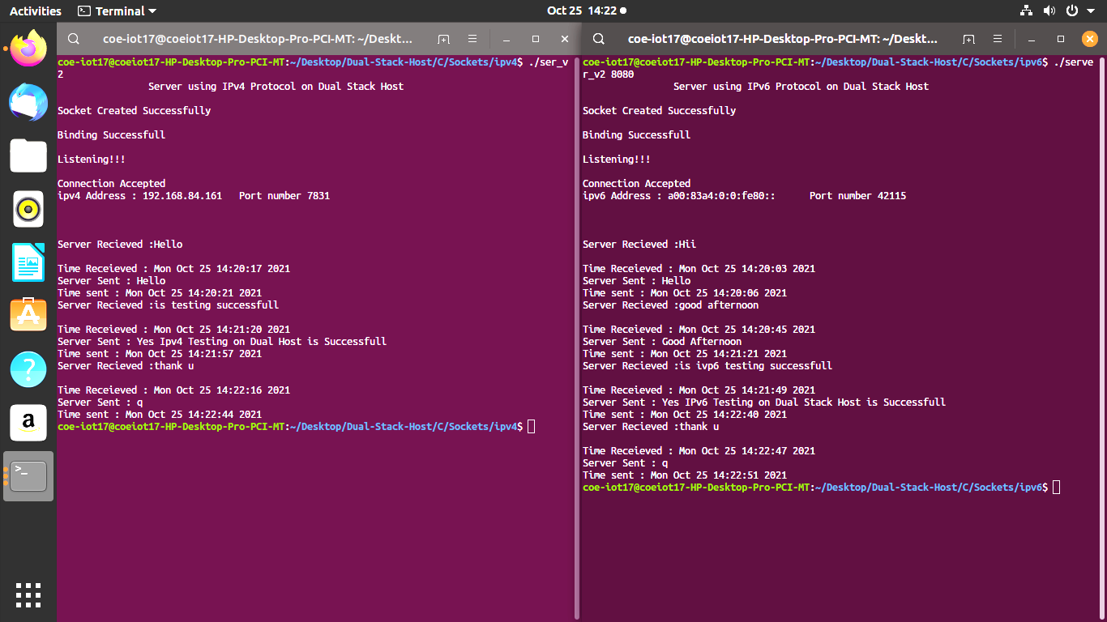
Both IPv4 and IPv6 Servers Running at the same time on Dual Stack Host

Slide 18
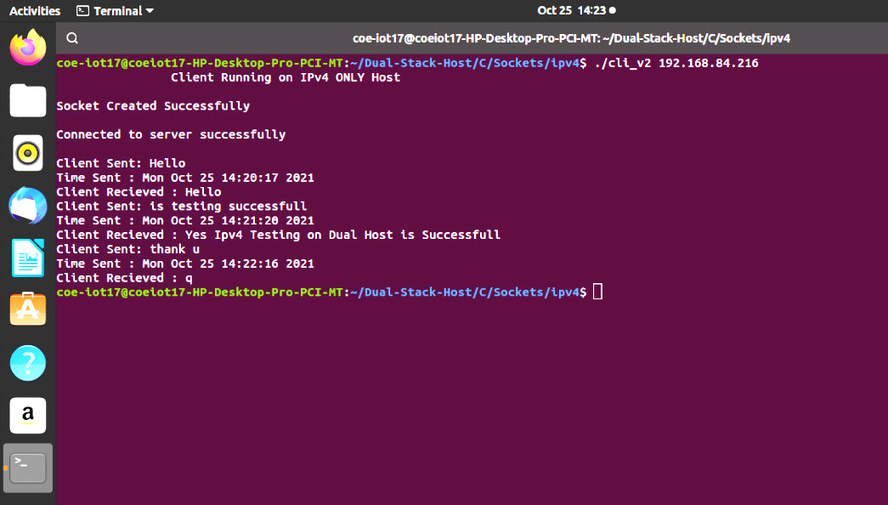
Client running on IPv4 Only Host

Slide 19
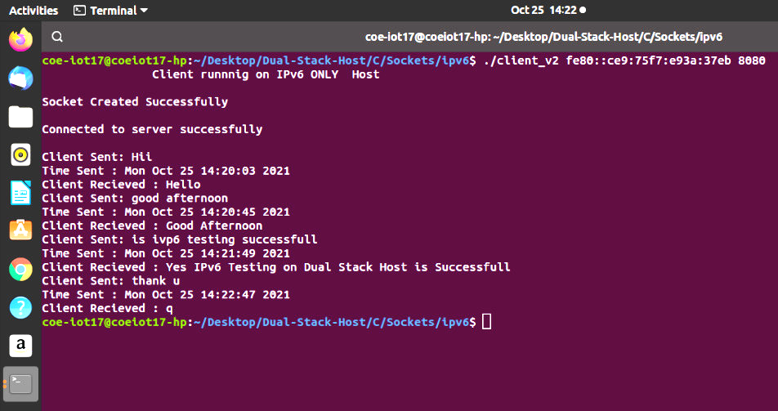
Client running on IPv6 Only Host

Slide 20
Addresses Used-Examples
IPv4 address
192.168.84.216
Link Local IPv6 Address
fe80::ce9:75f7:e93a:37eb

Slide 21
Timeline for the Project
Week-7 to Week-26 (20 weeks)
Seminar Hall Booking Application
Design – 2 weeks
Coding – 2 weeks
Testing – 2 weeks
NMIT IP IVR
Design – 2 weeks
Coding – 2 weeks
Testing - 2 weeks
Objective 1(UDP) – 1 week
Objective 2(UDP) – 1 week
Objective 3(UDP) – 1 week
Report – 3 weeks
Paper – 2 weeks
27-Oct-21

Slide 22
Phase lll – Work Assigned
Seminar Hall Booking Application
Design
Coding
Testing

